Slide 1
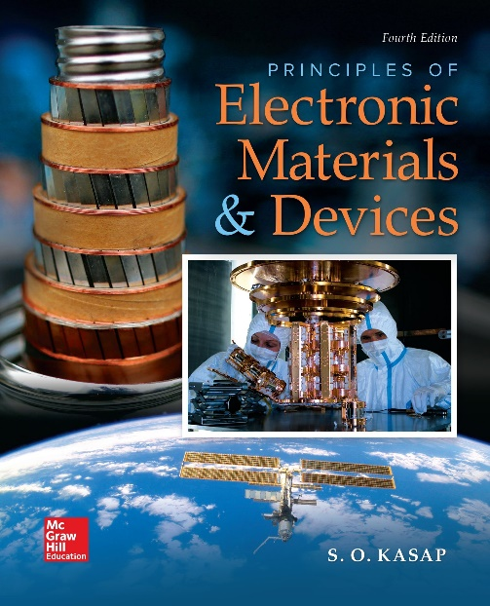
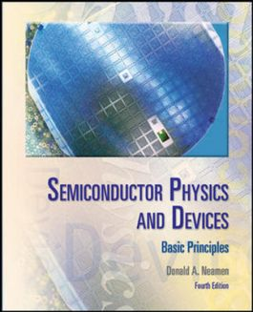

ELECTRONIC MATERIALS AND DEVICES
L | T | P | J | C
3 | 0 | 0 | 0 | 3
Dr. M. Saranya Nair
School of Electronics Engineering
VIT-Chennai Campus
E-mail : saranyanair.m@vit.ac.in
INTRODUCTION & MODULE 1

Slide 2
INTRODUCTION
Understanding the basic building blocks of matter

Slide 3
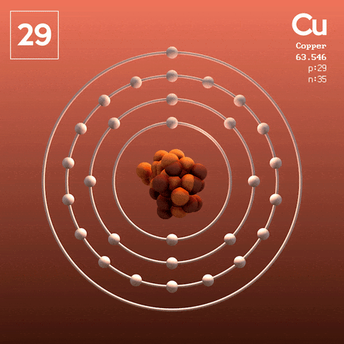
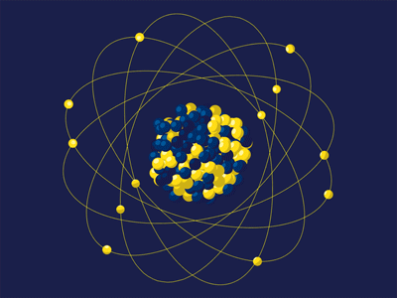
ATOMIC STRUCTURE AND ATOMIC NUMBER
The mass of the atom is concentrated at the nucleus, which contains protons and neutrons. Protons are positively charged particles, whereas neutrons are neutral particles, and both have about the same mass.
Although there is a Columbic repulsion between the protons, all the protons and neutrons are held together in the nucleus by the strong force, which is a powerful, fundamental, natural force between particles.

Slide 4
ATOMIC STRUCTURE AND ATOMIC NUMBER
When the protons and neutrons are brought together very closely, the strong force overcomes the electrostatic repulsion between the protons and keeps the nucleus intact. The number of protons in the nucleus is the atomic number of the element.
The electrons are assumed to be orbiting the nucleus. They are distributed in various shells and subshells within the shells, obeying certain occupation (or seating) rules.

Slide 5
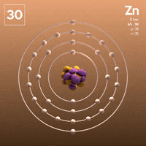
ATOMIC STRUCTURE AND ATOMIC NUMBER
The electrons occupying the outer subshells are the farthest away from the nucleus and have the most important role in atomic interactions, as in chemical reactions, because these electrons are the first to interact with outer electrons on neighboring atoms. The outermost electrons are called valence electrons and they determine the valency of the atom.
When a subshell is full of electrons, it cannot accept any more electrons and it is said to have acquired a stable configuration.

Slide 6
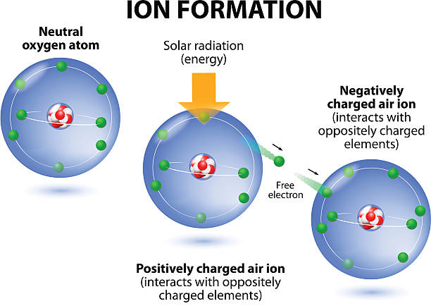
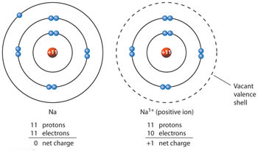
Ionization
The smallest energy required to remove a single electron from a neutral atom and thereby create a positive ion (cation) and an isolated electron is defined as the ionization energy of the atom.
The Na atom has only a single valence electron in its outer shell, which is the easiest to remove. The energy required to remove this electron is 5.1 electron volts (eV), which is the Na atom’s ionization energy.

Slide 7
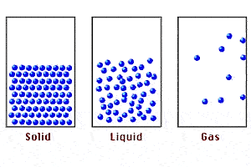
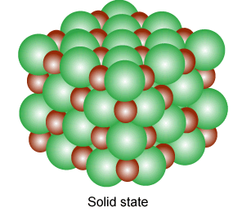
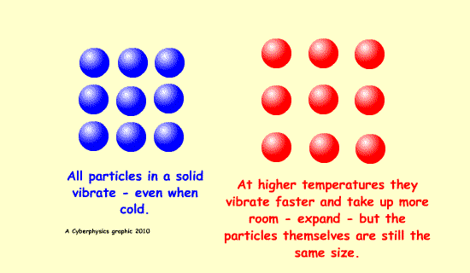
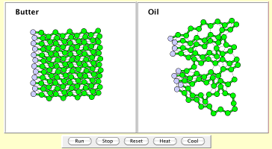
MOLECULES AND GENERAL BONDING PRINCIPLES
When two atoms are brought together, the valence electrons interact with each other and with the neighbour's positively charged nucleus. The result of this interaction is often the formation of a bond between the two atoms, producing a molecule

Slide 8
ELECTRONIC MATERIALS AND DEVICES
MODULE 1
Electrical and Thermal conduction in Solids
Crystalline state – Crystalline defects – Single Cyrstal Growth -Czochralski Growth – Amorphous Semiconductor - Classical Theory: Drude Model – Temperature dependence of resistivity – The Hall Effect and Hall Devices – Thermal conduction – Electrical conductivity of non-metals – Skin Effect – Thin metal films

Slide 9
Introduction to Solids
COVALENTLY BONDED SOLIDS: DIAMOND
METALLIC BONDING: COPPER
IONICALLY BONDED SOLIDS: SALT

Slide 10
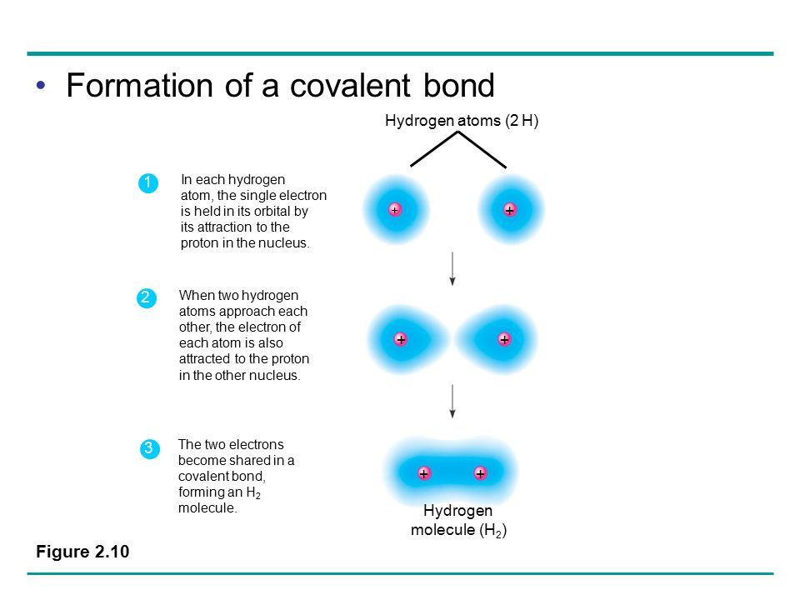

Slide 11
COVALENTLY BONDED SOLIDS
Two atoms can form a bond with each other by sharing some or all of their valence electrons
The covalent bond results from the sharing of valence electrons to complete the subshells of each atom.

Slide 12
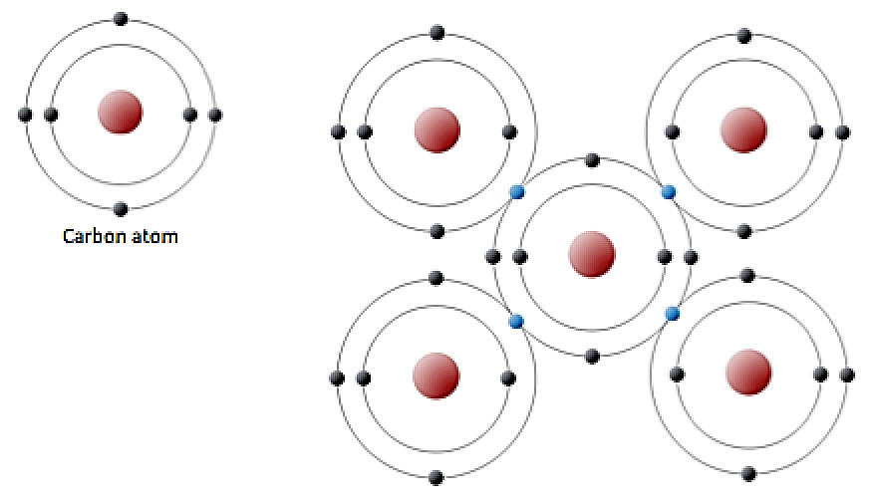
COVALENTLY BONDED SOLIDS DIAMOND
Each neighboring C atom can share electrons with other C atoms. E.g., diamond crystal, in which all the carbon atoms are covalently bonded to each other
The coordination number (CN) is the number of nearest neighbours for a given atom in the solid. The coordination number for a carbon atom in the diamond crystal structure is 4.

Slide 13
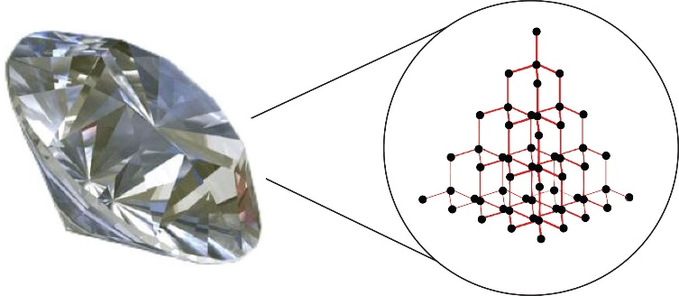
COVALENTLY BONDED SOLIDS : DIAMOND
Due to the strong Coulombic attraction between the shared electrons and the positive nuclei, the covalent bond energy is usually the highest for all bond types, leading to very high melting temperatures and very hard solids.
Covalently bonded solids are also insoluble in nearly all solvents. The strength of the covalent bond also make these materials nonductile (or nonmalleable).

Slide 14
COVALENTLY BONDED SOLIDS : DIAMOND
Further, since all the valence electrons are locked in the bonds between the atoms, these electrons are not free to drift in the crystal when an electric field is applied. Consequently, the electrical conductivity of such materials is very poor.

Slide 15
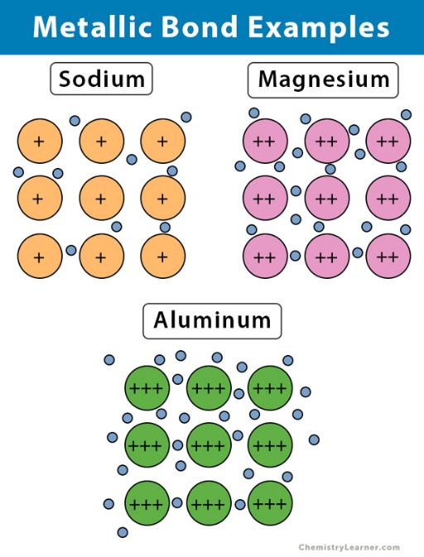
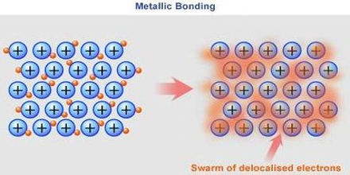
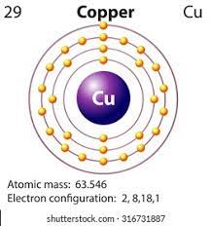
METALLIC BONDED SOLIDS COPPER
Metal atoms have only a few valence electrons, which are not very difficult to remove.
When many metal atoms are brought together to form a solid, these valence electrons are lost from individual atoms and become collectively shared by all the ions.

Slide 16
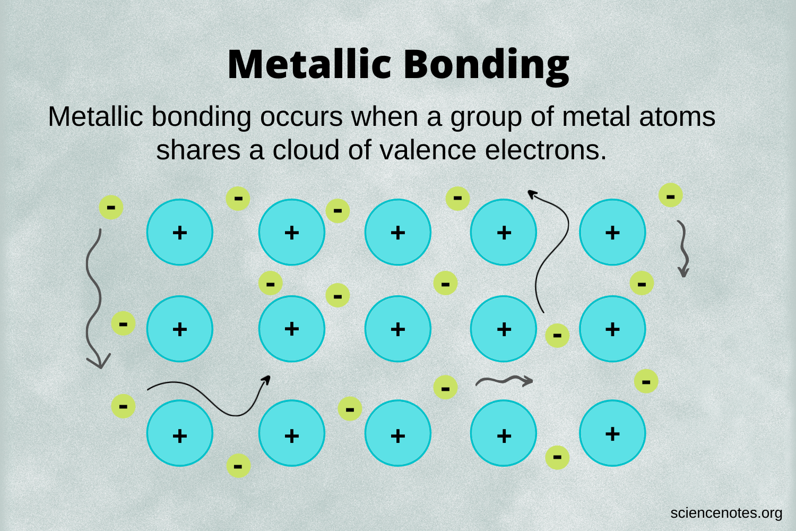
METALLIC BONDED SOLIDS COPPER
The valence electrons therefore become delocalized and form an electron gas or electron cloud, permeating the space between the ions.
Thus, the bonding in a metal is essentially due to the attraction between the stationary metal ions and the freely wandering electrons between the ions.

Slide 17
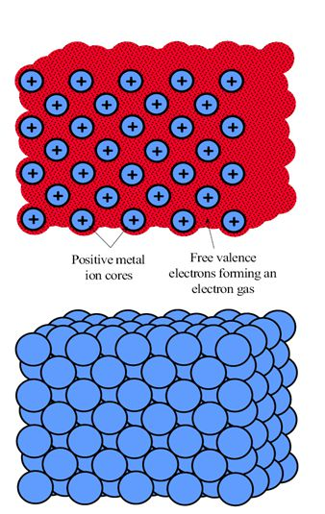

METALLIC BONDED SOLIDS COPPER
The metal ions try to get as close as possible, which leads to close-packed crystal structures with high coordination numbers, compared to covalently bonded solids.
Cu+ ions are packed as closely as possible by the gluing effect of the electrons between the ions, forming a crystal structure called the Face-Centered Cubic (FCC) structure.
The FCC crystal structure, has Cu+ ions at the corners of a cube and a Cu+ at the center of each cube-face.

Slide 18
METALLIC BONDED SOLIDS COPPER
Under an applied force, metal ions are able to move with respect to each other. Thus, metals tend to be ductile.
The “free” valence electrons in the electron gas can respond readily to an applied electric field and drift along the force of the field, which is the reason for the high electrical conductivity of metals.
Metals typically, also have good thermal conductivities; that is, they easily conduct heat.

Slide 19
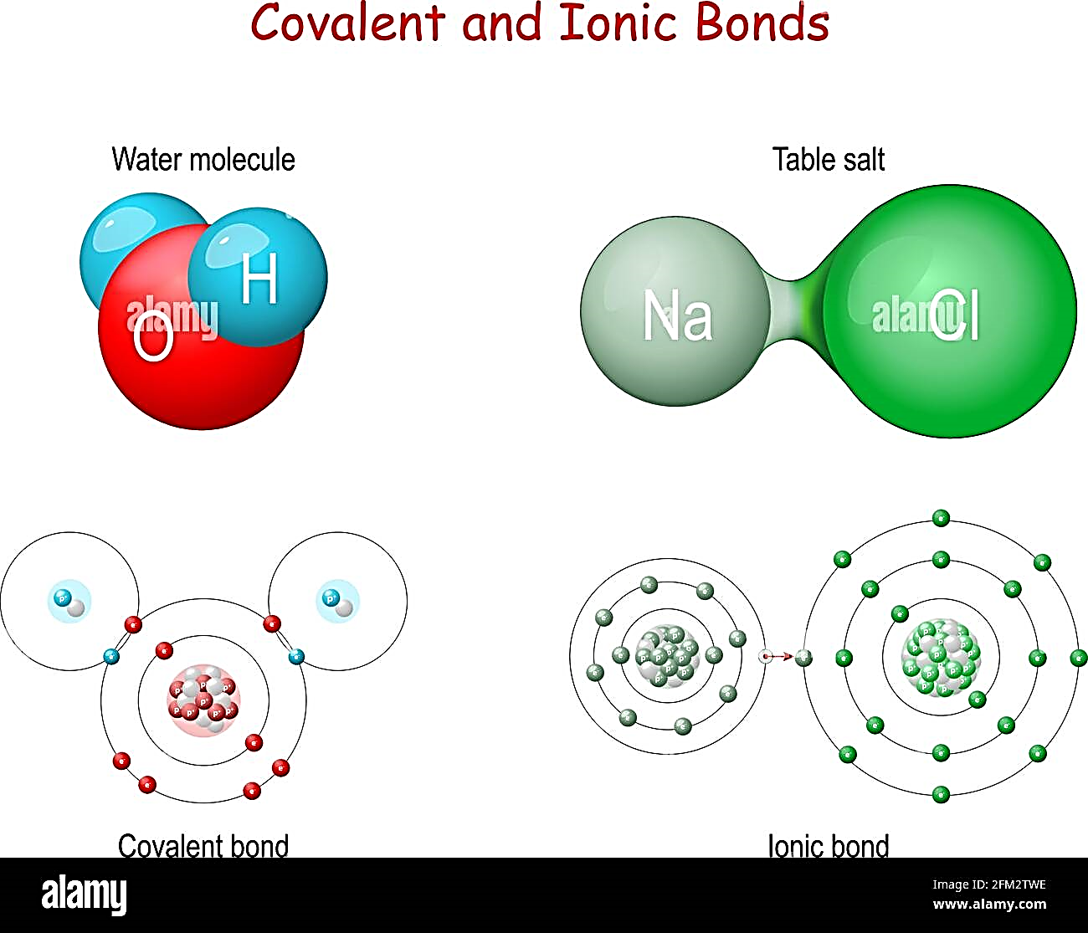
IONICALLY BONDED SOLIDS: SALT
NaCl, is a classic example of a solid in which the atoms are held together by ionic bonding.
Ionic bonding is frequently found in materials that normally have a metal and a non-metal as the constituent elements. Sodium (Na) is a metal with only one valence electron that can easily be removed to form an Na+ ion with complete subshells.
Chlorine has five electrons in its 3p subshell and can readily accept one more electron to close this subshell. By taking the electron given up by the Na atom, the Cl atom becomes negatively charged.
As a result of the Coulombic force, the two ions pull each other.

Slide 20
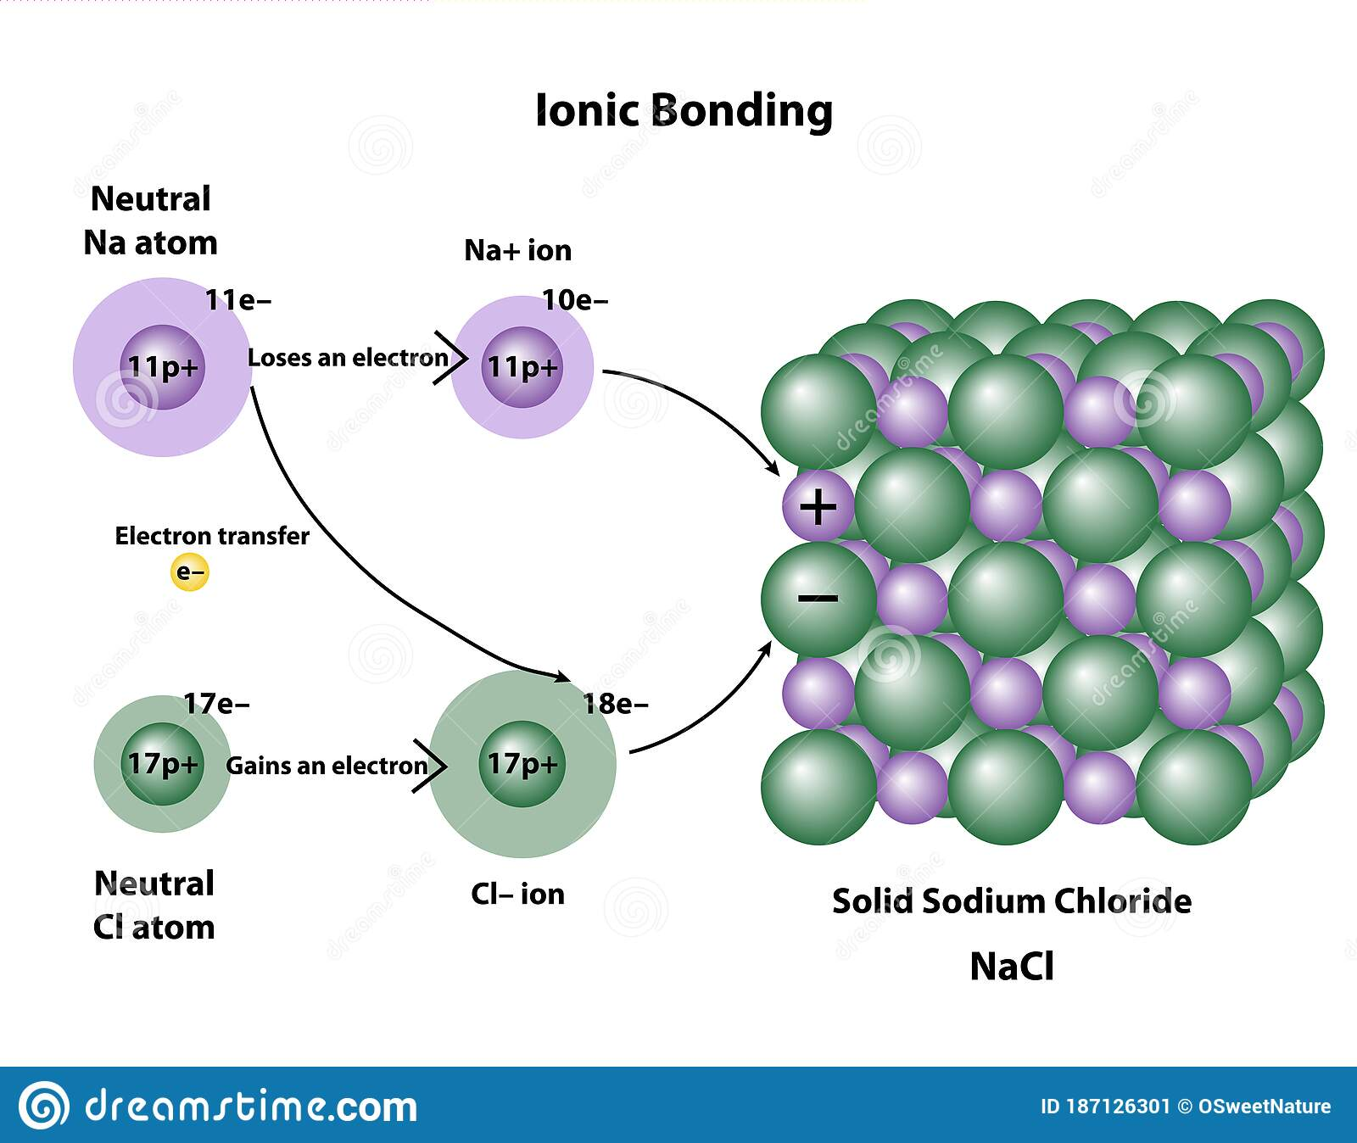
When many Na and Cl atoms are ionized and brought together, the resulting collection of ions is held together by the Coulombic attraction between the Na+ and Cl− ions.
There are also repulsive Coulombic forces between the Na+ ions themselves and between the Cl− ions themselves. For the solid to be stable, each Na+ ion must therefore have Cl− ions as nearest neighbors and vice versa so that like-ions are not close to each other.
Ionization energy of Na is 5.14 eV
Initially, about 5.1 eV is required to transfer the electron from the Na to Cl atom and thereby form Na+ and Cl− ions.

Slide 21
The energy with respect to two isolated Na+ and Cl− ions to break up a NaCl crystal into isolated Na+ and Cl− ions, which represents the ionic cohesive energy is 7.84 eV.
To take the crystal apart into its neutral atoms, we have to transfer the electron from the Cl− ion to the Na+ ion to obtain neutral Na and Cl atoms. It takes 3.61 eV to remove the electron from the Cl− ion, but 5.14 eV is released when it is put into the Na+ ion. Thus, we need 7.84 eV + 3.61 eV but get back 5.14 eV.
Bond energy per Na–Cl pair = 7.84 eV + 3.61 eV − 5.14 eV = 6.31 eV
The bonding energy per atom in solid NaCl is thus 6.31∕2 or 3.15 eV. The energy required to take solid NaCl apart into individual Na and Cl atoms is the atomic cohesive energy of the solid, which is 3.15 eV per atom.

Slide 22
There are no free or loose electrons to wander around in the crystal as in metals. Therefore, ionic solids are typically electrical insulators.
Compared to metals and covalently bonded solids, ionically bonded solids have lower thermal conductivity.

Slide 23
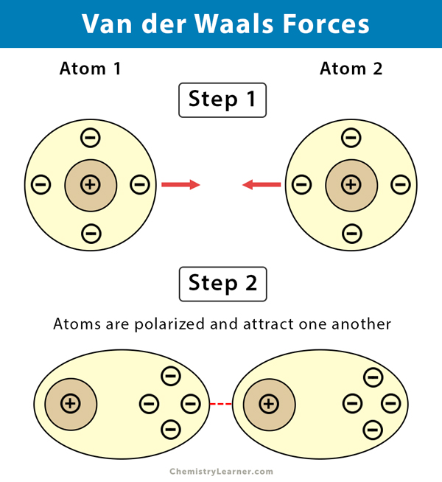
Covalent, ionic, and metallic bonds between atoms are known as primary bonds.
It may be thought that there should be no such bonding between the atoms of the inert elements as they have full shells and therefore cannot accept or lose any electrons, nor share any electrons. However, the fact that a solid phase of argon exists at low temperatures, below −189 °C, means that there must be some bonding mechanism between the Ar atoms. The magnitude of this bond cannot be strong because above −189 °C solid argon melts. there exists a weak type of attraction, the so-called van der Waals–London force.

Slide 24
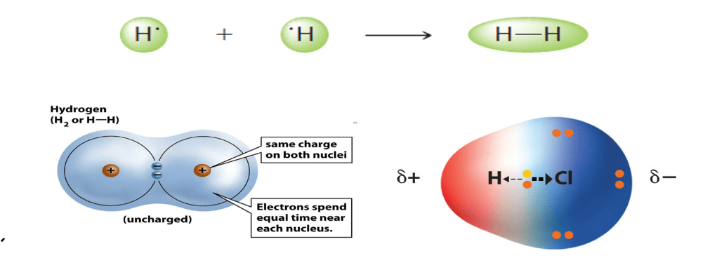
When there is a covalent-type bond between two different atoms, the electrons become unequally shared, because the two neighboring ion cores are different and hence have different electron-attracting abilities. The bond is no longer purely covalent; it has some ionic character.
Ceramic materials are compounds that generally contain metallic and non-metallic elements. They are well known for their brittle mechanical properties, hardness, high melting temperatures, and electrical insulating properties.

Slide 25
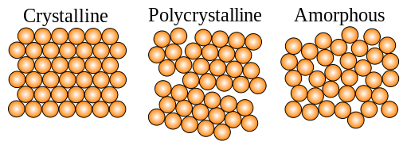
Types of Solids
Solids are rigid as the constituent particle is arranged close to each other. The molecules in solids are not moving in the same manner as those in liquids or gases.
The force between the constituent particles (atoms, molecules or ions) is very strong.

Slide 26
Types of Solids
There are two main categories of solids - Crystalline solids are those in which the atoms, ions, or molecules that make up the solid exist in a regular, well-defined arrangement. The smallest repeating pattern of crystalline solids is known as the unit cell, and unit cells are like bricks in a wall - they are all identical and repeating.
The other main type of solids are called the amorphous solids. Amorphous solids do not have much order in their structures. Though their molecules are close together and have little freedom to move, they are not arranged in a regular order as are those in crystalline solids.

Slide 27
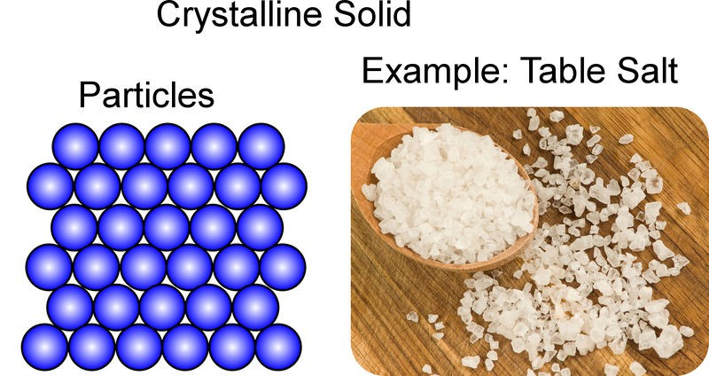
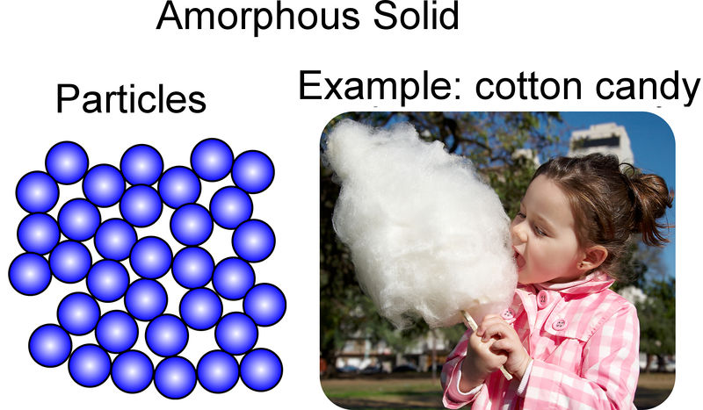
Crystalline Solids
Crystalline solids - Examples include Sodium Chloride, Quartz, Diamond, etc.
Crystalline solids start melting when it reaches a particular temperature.
Crystalline solids are true solids.

Slide 28
Exercise Ionic Solids, Metallic Solids, Covalent Solids
Positive metal ions in a sea of delocalized electrons.
Solids of non-metal form
Strong bond between adjacent atoms throughout the crystal.
The constituent particles are ions.
Hard and brittle in nature.
Formed by the arrangement of cations and anions by strong Coulombic forces
They have high melting point than ionic solids

Slide 29
Exercise Ionic Solids, Metallic Solids, Covalent Solids
Insulator in a solid-state but are conductors in a molten and aqueous state
The electrons are evenly spread out throughout the crystal.
Due to the presence of free and mobile electrons, they are responsible for high electrical and thermal conductivity
They are conductors in both solid and molten state
They have a high melting point
The physical nature of these solids are hard but they are malleable and ductile.

Slide 30
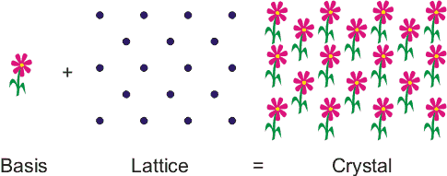
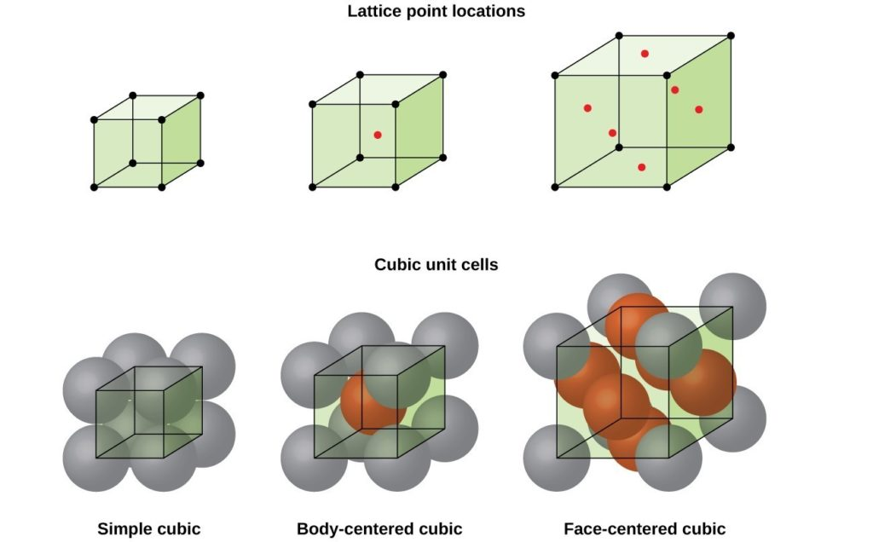
Crystalline State
A crystalline solid - atoms bond with each other in a regular pattern.
Nearly all metals, many ceramics and semiconductors are crystalline solids
All crystals can be described in terms of a lattice and a basis. A lattice is an infinite periodic array of geometric points in space, without any atoms. When we place an identical group of atoms (or molecules), called a basis, at each lattice point, we obtain the actual crystal structure. The crystal is thus a lattice plus a basis at each lattice point.

Slide 31
Crystalline State
The unit cell of the copper crystal is cubic with Cu atoms at its corners and one Cu atom at the center of each face. The unit cell of Cu is thus said to have a face-centered cubic (FCC) structure.
The length of the cubic unit cell is termed the lattice parameter a of the crystal structure.
The FCC crystal structure of Cu is known as a close-packed crystal structure because the Cu atoms are packed as closely as possible.
The volume of the FCC unit cell is 74 percent full of atoms, which is the maximum packing possible with identical spheres.

Slide 32
Crystalline State
By comparison, iron has a body centered cubic (BCC) crystal structure
The volume of the BCC unit cell is 68 percent full of atoms, which is lower than the maximum possible packing.
The FCC crystal structure is only one way to pack the atoms as closely as possible.

Slide 33
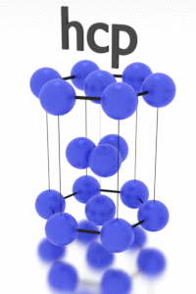
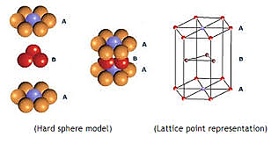
Crystalline State
In zinc, the atoms are arranged as closely as possible in a hexagonal symmetry, to form the hexagonal close-packed (HCP) structure
The atomic packing density in the HCP crystal structure is 74 percent, which is the same as that in the FCC structure.
Covalently bonded solids, such as silicon and germanium, have a diamond crystal structure
Although there are atoms at each corner and at the center of each face, indicating an FCC-like structure, there are four atoms within the cell as well.

Slide 34
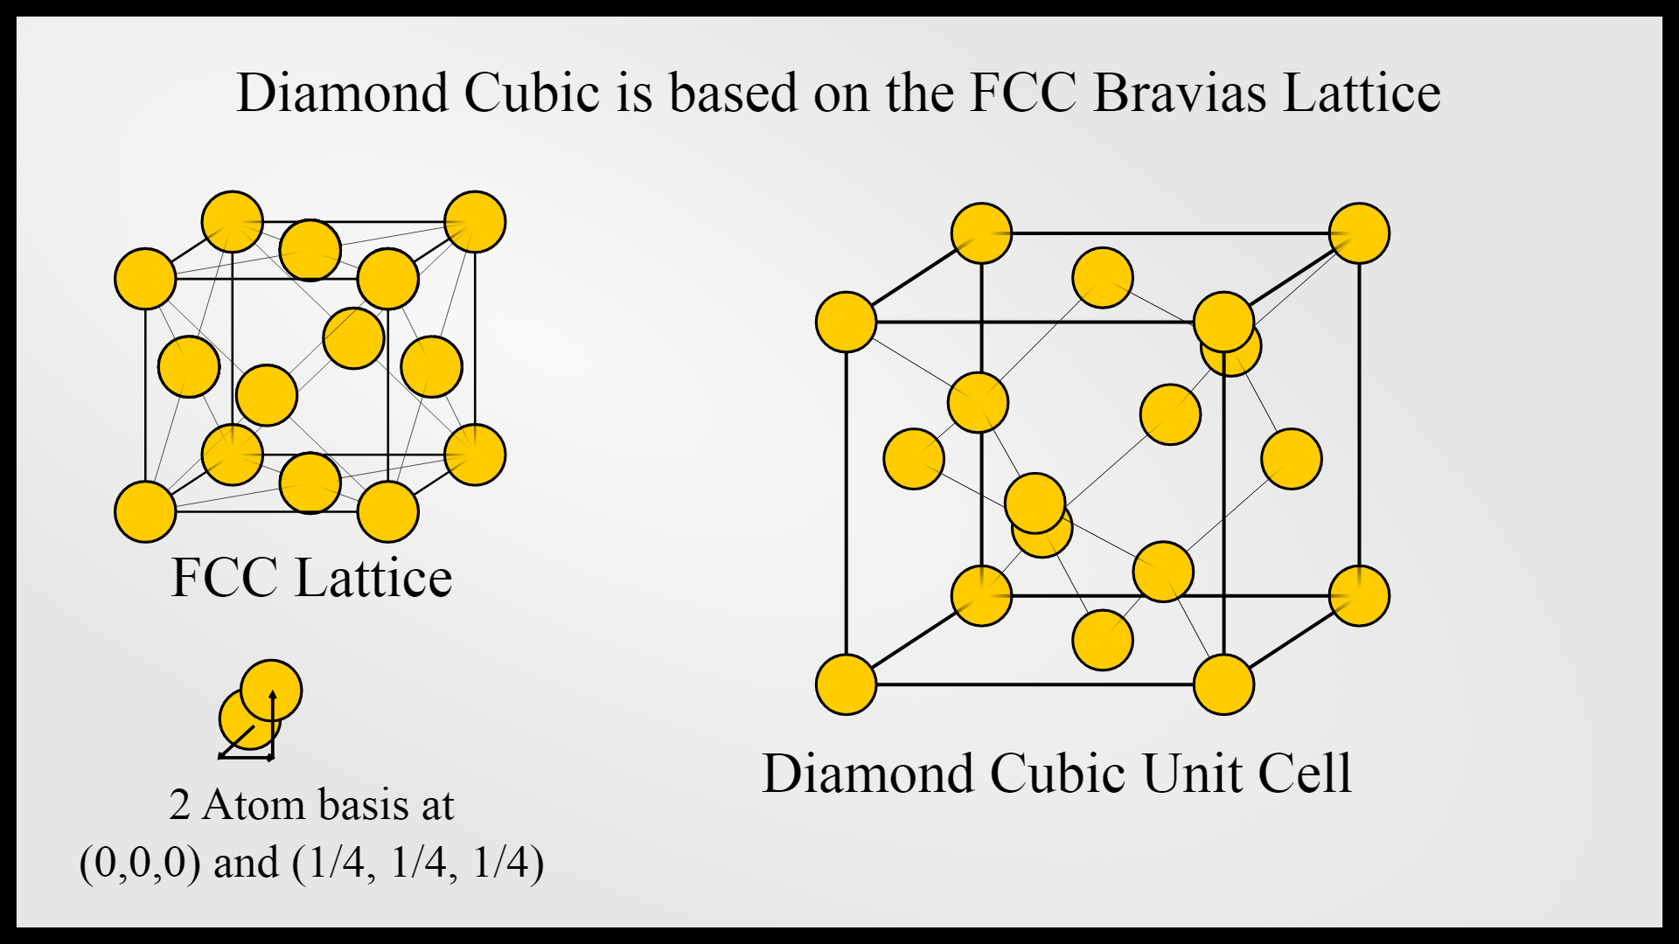
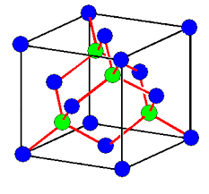

Slide 35
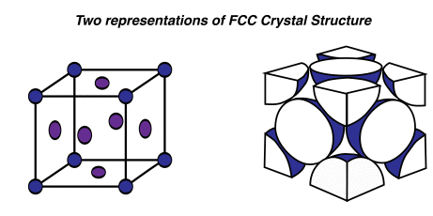
Consider the FCC unit cell of the copper crystal a. How many atoms are there per unit cell? b. If R is the radius of the Cu atom, find the lattice parameter a. c. Calculate the atomic packing factor (APF) d. Calculate the atomic concentration (number of atoms per unit volume) in Cu and the density of the crystal given that the atomic mass of Cu is 63.55 g mol−1 and the radius of the Cu atom is 0.128 nm.
APF =Volume of atoms in unit cell / Volume of unit cell
n_{at} = Number of atoms in unit cell / Volume of unit cell
ρ = Mass of all atoms in unit cell / Volume of unit cell

Slide 38
Relation : a vs R for different Unit cell Structures

Slide 39
CRYSTALLINE DEFECTS AND THEIR SIGNIFICANCE
By bringing all the atoms together to try to form a perfect crystal, we lower the total potential energy of the atoms as much as possible for that particular structure.
What happens when the crystal is grown from a liquid or vapor; do you always get a perfect crystal?
What happens when the temperature is raised? What happens when impurities are added to the solid?
There is no such thing as a perfect crystal. We must therefore understand the types of defects that can exist in a given crystal structure.

Slide 40
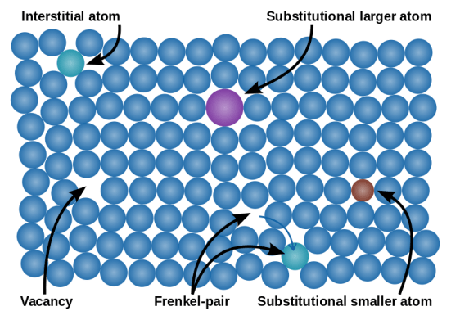
POINT DEFECTS VACANCIES AND IMPURITIES
Above the absolute zero temperature, all crystals have atomic vacancies or atoms missing from lattice sites in the crystal structure. The vacancies exist as a requirement of thermal equilibrium and are called thermodynamic defects.
Vacancies introduce disorder into the crystal by upsetting the perfect periodicity of atomic arrangements.
We know that all the atoms in a crystal vibrate about their equilibrium positions. At some instant, there may be one atom with sufficient energy to break its bonds

Slide 41
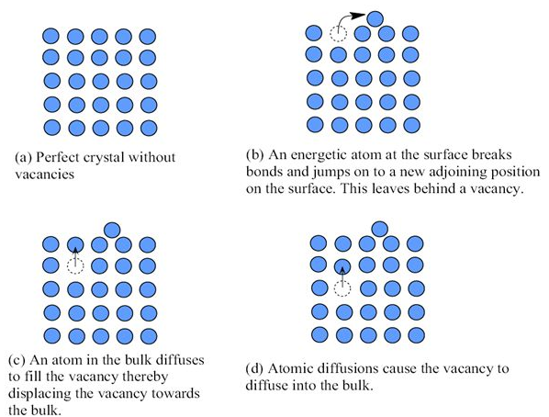
This leaves a vacancy behind, just below the surface
This vacancy can then diffuse into the bulk of the crystal, because a neighboring atom can diffuse into it.
Suppose that Ev is the average energy required to create such a vacancy.
Then only a fraction, exp(−Ev∕kT), of all the atoms in the crystal can have sufficient energy to create vacancies.
If the number of atoms per unit volume in the crystal is N, then the vacancy concentration n_{v} is given by
n_{v} = N exp(−Ev/kT)

Slide 42
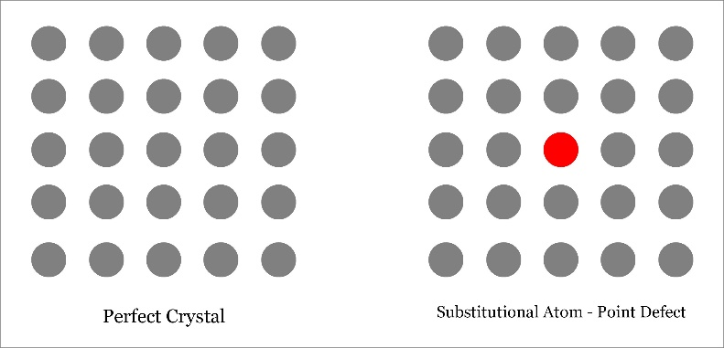
Although we considered only one possible vacancy creation process there are other processes that also create vacancies. Furthermore, we have shown the vacancy to be the same size in the lattice as the missing atom, which is not entirely true.
Vacancies are only one type of point defect in a crystal structure.
The crystal structure may contain impurities, either naturally or as a consequence of intentional addition, as in the case of silicon crystals grown for microelectronics.
If the impurity atom substitutes directly for the host atom, the result is called a substitutional impurity and the resulting crystal structure is that of a substitutional solid solution

Slide 43
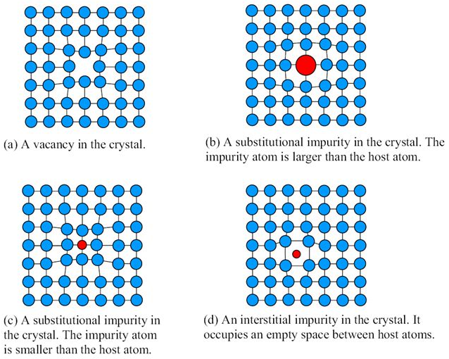
When a Si crystal is “doped” with small amounts of arsenic (As) atoms, the As atoms substitute directly for the Si atoms in the Si crystal; that is, the arsenic atoms are substitutional impurities.
The impurity atom can also place itself in an interstitial site, that is, in a void between the host atoms, as carbon does in the BCC iron crystal. In that case, the impurity is called an interstitial impurity.

Slide 44
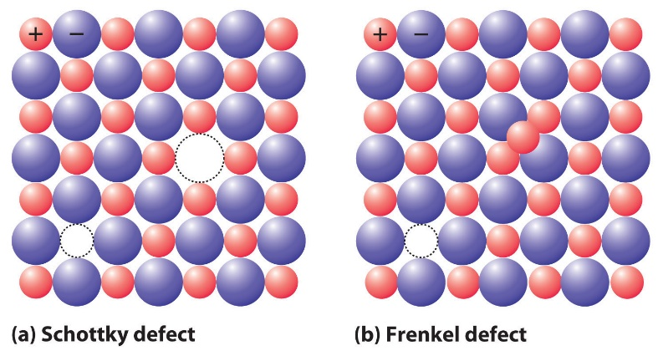
In general, the impurity atom distort the lattice around it.
For example, if a substitutional impurity atom is larger than the host atom, the neighboring host atoms will be pushed away.
The crystal region around an impurity is therefore distorted from the perfect periodicity. A smaller substitutional impurity atom will pull in the neighboring atoms
Schottky defect - This involves a missing cation–anion pair (which may have migrated to the surface), so the neutrality is maintained.
Frenkel defect - which occurs when a host ion is displaced into an interstitial position, leaving a vacancy at its original site.
n_{v} = N exp(−Ev/kT)

Slide 45
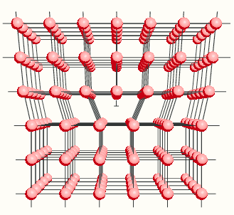
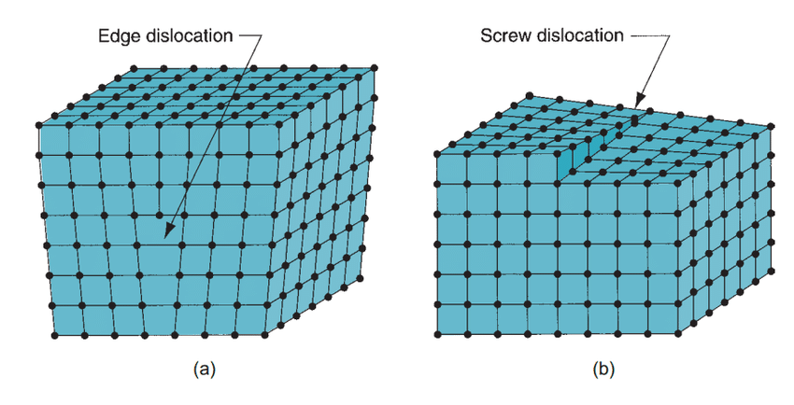
LINE DEFECTS: EDGE AND SCREW DISLOCATIONS
EDGE DISLOCATIONS - A line defect is formed in a crystal when an atomic plane terminates within the crystal instead of passing all the way to the end of the crystal
It is clear that the atoms around the dislocation line have been effectively displaced from their perfect crystal equilibrium positions
There are regions of compression and tension above / below the dislocation line

Slide 46
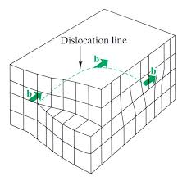
Another type of dislocation is the screw dislocation, which is essentially a shearing of one portion of the crystal with respect to another
The phenomenon of plastic or permanent deformation of a metal depends totally on the presence of dislocations
In the case of electrical properties of metals, that dislocations increase the resistivity of materials, cause significant leakage current in a pn junction, and give rise to unwanted electronic noise in various semiconductor devices.

Slide 47
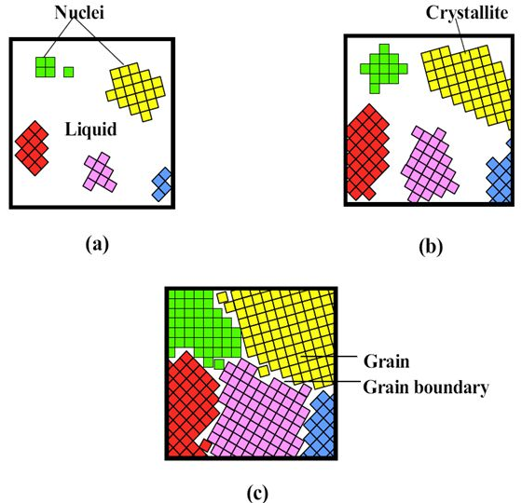
PLANAR DEFECTS
When a liquid is cooled, solidification does not occur at every point in the liquid; rather, it occurs at certain sites called nuclei, which are small crystal-like structures containing perhaps 50 to 100 atoms.
The liquid atoms adjacent to a nucleus diffuse into the nucleus, thereby causing it to grow in size to become a small crystal, or a crystallite, called a grain.

Slide 48
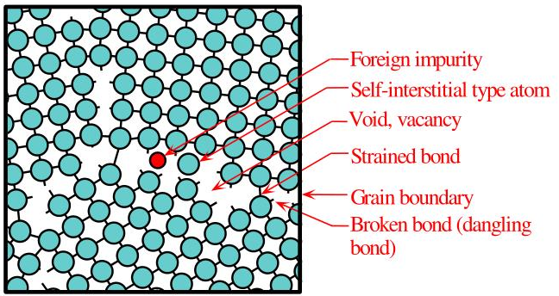
The atoms can diffuse more easily along a grain boundary because (a) less bonds need to be broken due to the presence of voids and (b) the bonds are strained and easily broken anyway.

Slide 49
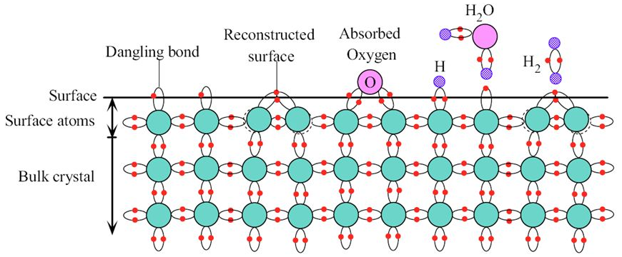
SURFACE DEFECTS
In describing crystal structures, we assume that the periodicity extends to infinity which means that the regular array of atoms is not interrupted anywhere by the presence of real surfaces of the material.
When the crystal lattice is abruptly terminated by a surface, the atoms at the surface cannot fulfill their bonding requirements

Slide 50
The atoms at the surface are left with dangling bonds, bonds that are half full. These dangling bonds are looking for atoms to which they can bond.
Two neighboring surface atoms can share each other’s dangling bond electrons, that is, form a surface bond with each other. This bonding between surface atoms causes a slight displacement of the surface atoms and leads to a surface that has been reconstructed.
Atoms from the environment can also bond with the atoms on the crystal surface.
For example, a hydrogen atom can be captured by a dangling bond at the surface to form a chemical bond as a result of which hydrogen becomes absorbed. Primary bonding of foreign atoms to a crystal surface is called chemisorption.

Slide 51
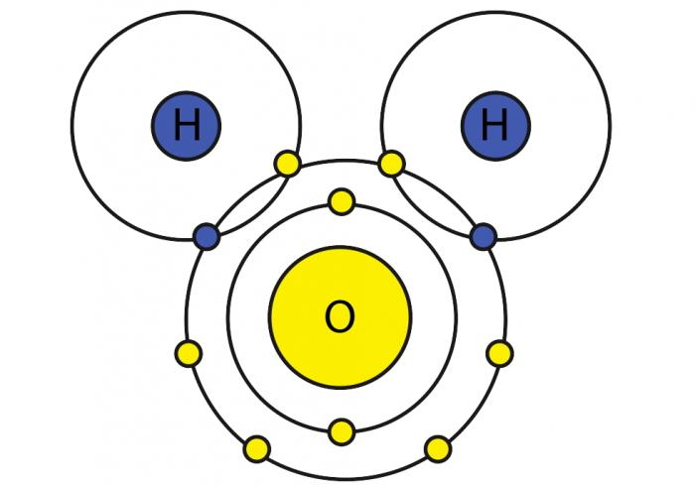
However, the H2O molecule cannot form a covalent bond, but, because of hydrogen bonding, it can form a secondary bond with a surface Si atom and become adsorbed. Secondary bonding of foreign atoms or molecules to a crystal surface is called physisorption (physical adsorption).
Water molecules in the air can readily become adsorbed at the surface of a crystal.
At sufficiently high temperatures, some of the absorbed foreign surface atoms can diffuse into the crystal volume to become bulk impurities. Many substances have a natural oxide layer on the surface that starts with the chemical bonding of oxygen atoms to the surface atoms and the subsequent growth of the oxide layer.
The surface condition of a Si crystal wafer in microelectronics is normally controlled by first etching the surface and then oxidizing it at a high temperature to form a SiO2 passivating layer on the crystal surface. This oxide layer is an excellent barrier against the diffusion of impurity atoms into the crystal.

Slide 52
The energy of vacancy formation in the Ge crystal is about 2.2 eV. Calculate the fractional concentration of vacancies in Ge at 938 °C, just below its melting temperature. What is the vacancy concentration given that the atomic mass and density of Ge are 72.64 g mol⁻¹ and 5.32 g cm⁻³, respectively?

Slide 53
ELECTRICAL AND THERMAL CONDUCTION IN SOLID / CRYSTALS
Electrical conduction involves the motion of charges in a material under the influence of an applied electric field.
A material can generally be classified as a conductor if it contains a large number of “free” or mobile charge carriers. In metals, due to the nature of metallic bonding, the valence electrons from the atoms form a sea of electrons that are free to move within the metal and are therefore called conduction electrons.
In the presence of an electric field, the conduction electrons attain an average velocity, called the drift velocity, that depends on the field.
Going to study the fundamental equations that govern electrical conduction in solids. A key concept will be the drift mobility, which is a measure of the ease with which charge carriers in the solid drift under the influence of an external electric field.
Good electrical conductors, such as metals, are also known to be good thermal conductors. The conduction of thermal energy from higher to lower temperature regions in a metal involves the conduction electrons carrying the energy.

Slide 54
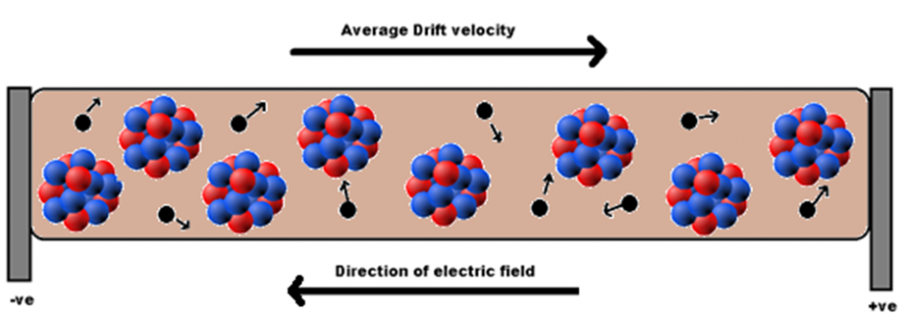
ELECTRICAL AND THERMAL CONDUCTION IN SOLIDS CLASSICAL THEORY: THE DRUDE MODEL
The electric current density J is defined as the net amount of charge flowing across a unit area per unit time
The direction of electron motion is opposite to that of the electric field E_{x} . The average velocity of the electrons in the x direction at time t is denoted v_{dx}(t).
This is called the drift velocity, which is the instantaneous velocity v_{x} in the x direction averaged over many electrons
J_{x} = Δq/A Δt

Slide 55
Suppose that n is the number of electrons per unit volume in the conductor (n = N∕V). In time Δt, electrons move a distance Δx = v_{dx} Δt, so the total charge Δq crossing the area A is enA Δx.
The current density in the x direction is J_{x} = Δq/A Δt = enAv_{dx} Δt/A Δt = env_{dx}
J_{x}(t) = env_{dx}(t)
This is valid because all the electrons within distance Δx pass through A; thus, n(A Δx ) is the total number of electrons crossing A in time Δt.

Slide 56
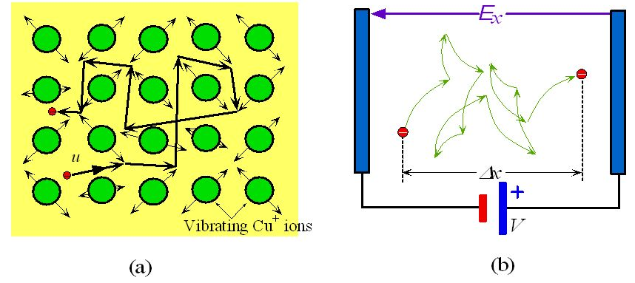
To relate “Jx to Ex”, we will consider a crystal.
In general, the crystal will not be perfect and the atoms will not be stationary.
There will be crystal defects, vacancies, dislocations, impurities, etc., which will scatter the conduction electrons.
Due to their thermal energy, the atoms will vibrate. An electron will not be able to avoid collisions with vibrating atoms; consequently, it will be “scattered” from one atom to another.

Slide 57
The copper atom has a single valence electron, and this electron is loosely bound. The valence electrons detach themselves from their parents and wander around freely in the solid, forming a kind of electron cloud or gas.
These mobile electrons are free to respond to an applied field, creating a current density Jx. The valence electrons in the electron gas are therefore conduction electrons.
A conduction electron in the electron gas moves about randomly in a metal being frequently and randomly scattered by thermal vibrations of the atoms.
In the absence of an applied field there is no net drift in any direction.
When the conductor is connected to a battery and an electric field is applied to the crystal, the electron experiences an acceleration in the x direction in addition to its random motion, so after some time, it will drift a finite distance in the x direction.

Slide 58
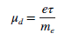
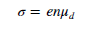
To calculate the drift velocity vdx of the electrons due to applied field Ex,
shows that the drift velocity increases linearly with the applied field. The constant of proportionality eτ∕me has been given a special name and symbol. It is called the drift mobility μ_{d}, which is defined as
τ is the mean free time, or the mean time between collisions (also known as the mean scattering time)
J_{x}(t) = env_{dx}(t)

Slide 59
Suppose that the mean speed of the electrons (not the drift velocity) is u. Then an electron moves a distance ℓ = uτ in mean free time τ, which is called the mean free path.
The drift mobility and conductivity become,
μ_{d} = eℓ/m_{e}u
σ = en μ_{d} = e²nℓ/m_{e}u

Slide 61
DA Problem 1: Calculate the drift mobility and the mean scattering time of conduction electrons in copper at room temperature, given that the conductivity of copper is 5.9 × 10⁵ Ω−1 cm−1. The density of copper is 8.96 g cm−3 and its atomic mass is 63.5 g mol−1. If the mean speed of the conduction electrons in Cu is roughly 1.6 × 10⁶ m s−1, what is the mean free path between collisions?
DA Problem 2: What is the applied electric field that will impose a drift velocity equal to 0.1 percent of the mean speed u (∼10⁶ m s−1) of conduction electrons in copper?
What is the corresponding current density and current through a Cu wire of diameter 1 mm?

Slide 62
TEMPERATURE DEPENDENCE OF RESISTIVITY
When the conduction electrons are only scattered by thermal vibrations of the metal ions, then τ in the mobility expression refers to the mean time between scattering events by this process. The resulting conductivity and resistivity are denoted by σ_{T} and ρ_{T}, where the subscript T represents “thermal vibration scattering.”
To find the temperature dependence of σ, we first consider the temperature dependence of the mean free time τ, since this determines the drift mobility.

Slide 63
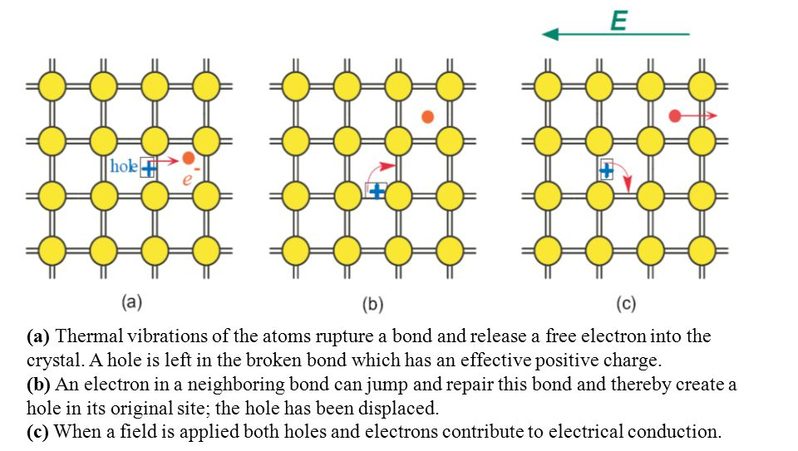

ELECTRICAL CONDUCTIVITY OF NONMETALS
All metals are good conductors because they have a very large number of conduction electrons free inside the metal. We should therefore expect solids that do not have metallic bonding to be very poor conductors, indeed insulators.
Suppose that n and p are the concentrations of electrons and holes in a semiconductor crystal. If electrons and holes have drift mobilities, then the overall conductivity of the crystal is given by
Semiconductors have much lower conductivities due to their lower concentration of free charge carriers
The hole has been displaced in
the opposite direction to the electron jump by this bond switching

Slide 64


Ionic Crystals and Glasses
Crystal defects in an ionic crystal lead to mobile charges that can contribute to the conduction process.
All ionic crystals possess vacancies, interstitial ions as a requirement of thermal equilibrium.
These interstitial ions can jump, i.e., diffuse, from one interstitial site to another
Drift by diffusion in the presence of a field.
A positive ion at an interstitial site such as that shown in Figure always prefers to jump into a neighboring interstitial site along the direction of the field because it experiences an effective force in this direction.
When an ion with charge qion jumps a distance d along the field, its potential energy decreases by qionEd.
Diffusion is a thermally activated process. Thus, we expect the conductivity to be thermally activated.

Slide 65

THE HALL EFFECT AND HALL DEVICES
When we apply a magnetic field in a perpendicular direction to the applied field (which is driving the current), we find there is a transverse field in the sample that is perpendicular to the direction of both the applied field Ex and the magnetic field Bz, that is, in the y direction.
Putting a voltmeter across the sample, gives a voltage reading V_{H}. The applied field Ex drives a current Jx in the sample. The electrons move in the −x direction, with a drift velocity vdx.
Because of the magnetic field, there is a force (called the Lorentz force) acting on each electron and given by Fy = −evdx Bz. The direction of this Lorentz force is the −y direction.

Slide 67
The force F acting on a charge q moving with a velocity v in a magnetic field B is given through the vector product
F = qv × B
All moving charges experience the Lorentz force as a result of which there is a negative charge accumulation near the bottom of the sample and a positive charge near the top of the sample.
The accumulation of electrons near the bottom results in an internal electric field E_{H} in the −y direction. This is called the Hall field and gives rise to a Hall voltage V_{H} between the top and bottom of the sample.
Electron accumulation continues until the magnetic-field force that pushes the electrons down just balances the force eE_{H} that prevents further accumulation.
Therefore, in the steady state,
e E_{H} = e v_{dx} B_{z}

Slide 68
However, Jx = env_{dx}. Therefore, we can substitute for v_{dx} to obtain eEH = JxBz∕n
There are many instances when it is necessary to measure magnetic fields, and the Hall effect is ideally suited to such applications.
Ignition systems, to speed controls, position detectors, alignment controls.
For metals

Slide 69
Thank you

